Slide 1
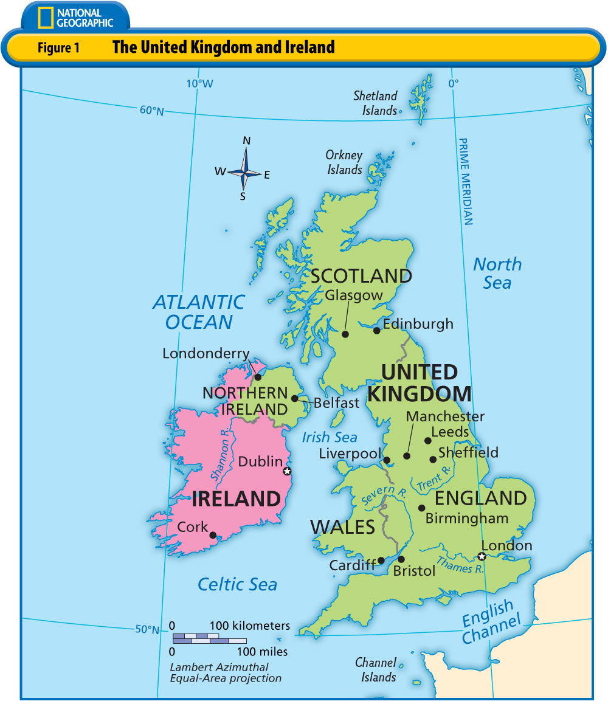

Slide 2
The United Kingdom
Four regions make up the United Kingdom: England (London), Scotland (Edinburgh), and Wales (Cardiff) on the island of Great Britain, and Northern Ireland (Belfast) on the nearby island of Ireland.
Everyone in the United Kingdom is considered British, but people sometimes differentiate by referring to the English, the Scots, the Welsh, or the Irish.
The island of Great Britain is separated from the rest of Europe by the English Channel.

Slide 3
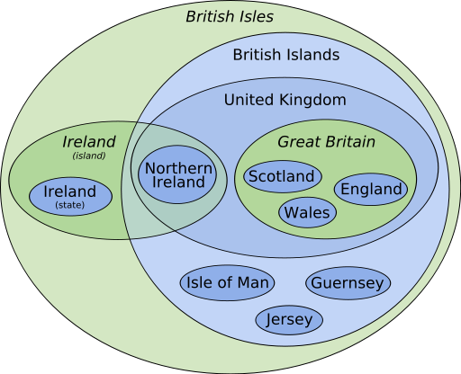
Green: Physical Distinction Blue: Legal Distinction

