Slide 1
Trip to France
March 14-26, 2013

Slide 3
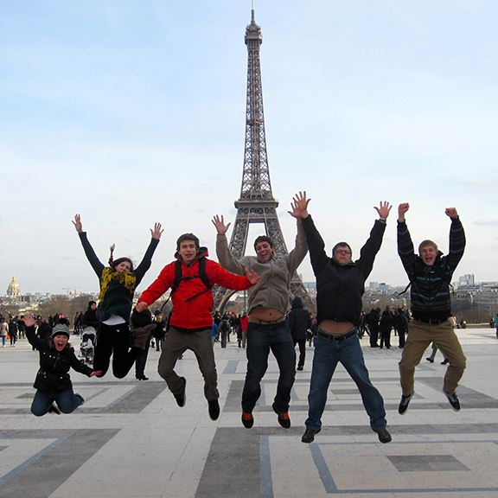
Eiffel Tower

Slide 4
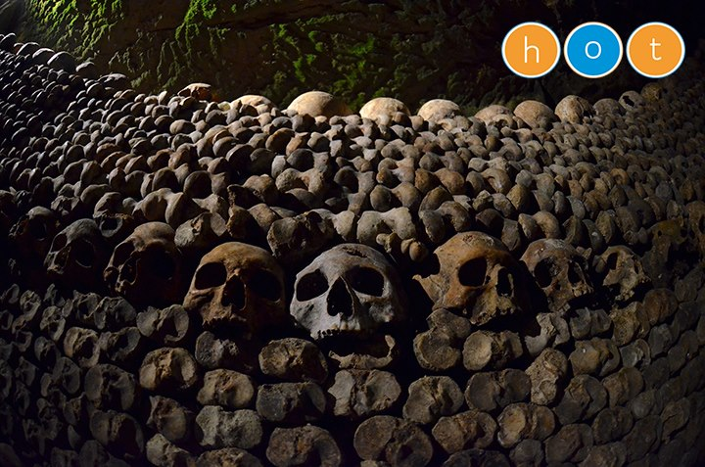
Catacombes

Slide 5
Chateau d' Chambord

Slide 6
Mont St. Michel

Slide 7
Omaha Beach

Slide 8
Versailles Palace

Slide 9
Pompidou

Slide 10
Napoleon's Tomb

Slide 11
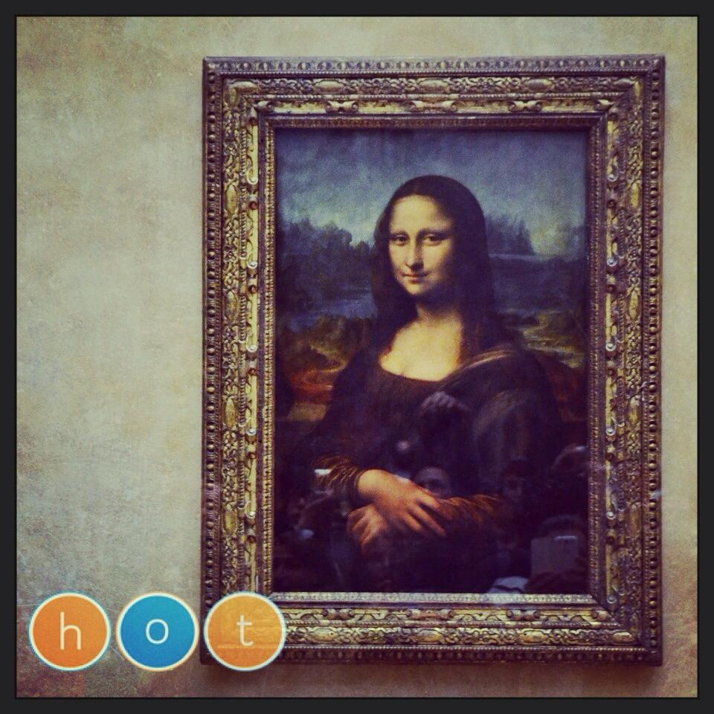
Louvre

Slide 12
Notre Dame cathedral

Slide 13
"Locks of Love" bridge

