Slide 1
France
John A. Borkowski/Malcolm G. Peters

Slide 2
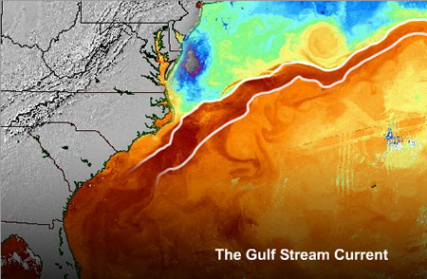
Gulf Stream Current
Part of Thermohaline Circulation
Thermohaline Circulation: part of the large-scale ocean circulation that is driven by global density gradients created by surface heat and freshwater fluxes. The adjective thermohaline derives from thermo- referring to temperature and -haline referring to salt content, factors which together determine the density of sea water.
Gulf Stream Current: powerful, warm, and swift Atlantic ocean current that originates at the tip of Florida, and follows the eastern coastlines of the United States and Newfoundland before crossing the Atlantic Ocean

Slide 3
Two Major Climate
Temperate: having temperatures that are not too hot or too cold
Sirocco: all-inclusive name given to hot and subsequently humid southeast to southwest winds originating as hot, dry desert-air over Northern Africa, flowing northward into the southern Mediterranean basin.
Alps: one of the great mountain range systems of Europe stretching approximately 1,200 kilometers (750 mi) across eight Alpine countries from Austria and Slovenia in the east, Switzerland, Liechtenstein, Germany, and France, to the west, and Italy and Monaco to the south.
Alps Mountain: Berlin Wall?

Slide 4
Comparison of France and UK
France
United Kingdom
Comparative Area: Colorado
Coastline: 3,427km
Terrain: mostly flat plains or gently rolling hills in north and west; remainder is mountainous, especially Pyrenees in south, Alps in east
Climate: generally cool winters and mild summers, but mild winters and hot summers along the Mediterranean; occasional strong, cold, dry, north-to-northwesterly wind known as mistral
Comparative Area: Twice the size of PA. Slightly smaller than Oregon
Coastline: 17,820km
Terrain: mostly rugged hills and low mountains in the north and west, with level to rolling plains in the east and southeast
Climate: generally cool winters and mild summers, but mild winters and hot summers along the Mediterranean; occasional strong, cold, dry, north-to-northwesterly wind known as mistral

Slide 5
Ocean Climate
Where in USA? Washington and Oregon
known as marine, west coast and maritime
Characteristics
France
west coasts at the middle latitudes of most continents, and generally features warm (but not hot) summers and cool (but not cold) winters, with a relatively narrow annual temperature range
It typically lacks a dry season, as precipitation is more evenly dispersed throughout the year.

Slide 6
Continental Climate
Where in North America? Northern USA and Canada
known as Humid Continental Climate
France
Characteristics
climate characterized by important annual variation in temperature due to the lack of significant bodies of water nearby.
Often winter temperature is cold enough to support a fixed period of snow each year, and relatively moderate precipitation occurring mostly in summer
US: Northern of Mid-West, New England,

Slide 7
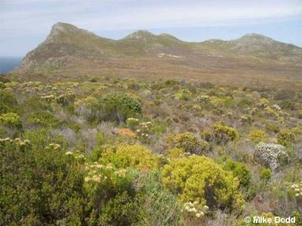
Mediterranean Climate
Ask me about Old World vs. New World with wine
known as Marine, West Coast and Maritime
Characteristics
France
mild, rainy winters and hot, dry summers, which supports characteristic Mediterranean forests, woodlands, and scrub vegetation
Old World region where olive trees grow.
USA: Southern California

Slide 8
Mountain Climate
A callout, this can be edited or deleted
known as Alpine or Highland Climate
France
Characteristics
average weather for a region above the tree line (timberline)
Trees can’t tolerate to grow over 12,000 feet.

